Slide 1

Python Machine Learning: ENSEMBLE MODELS
Žydrūnė Kelpšaitė
Data Analyst

Slide 2
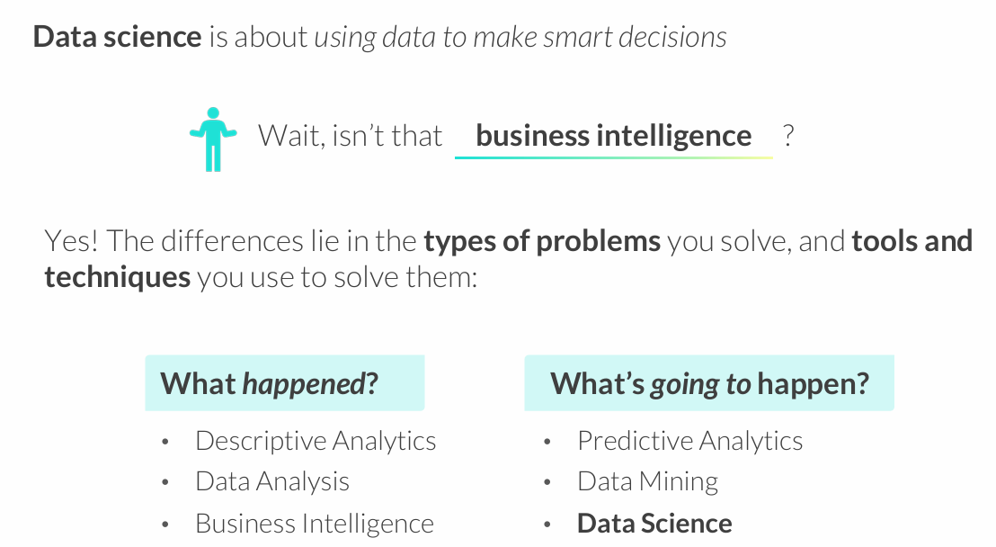
WHAT IS DATA SCIENCE?

Slide 3
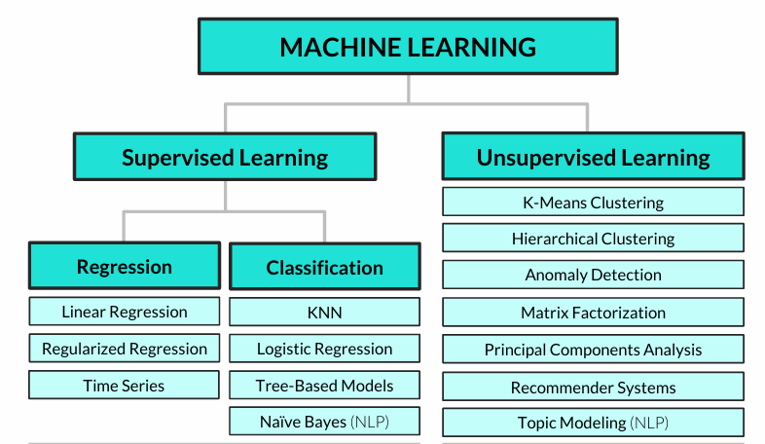
Common machine learning algorithms

Slide 4
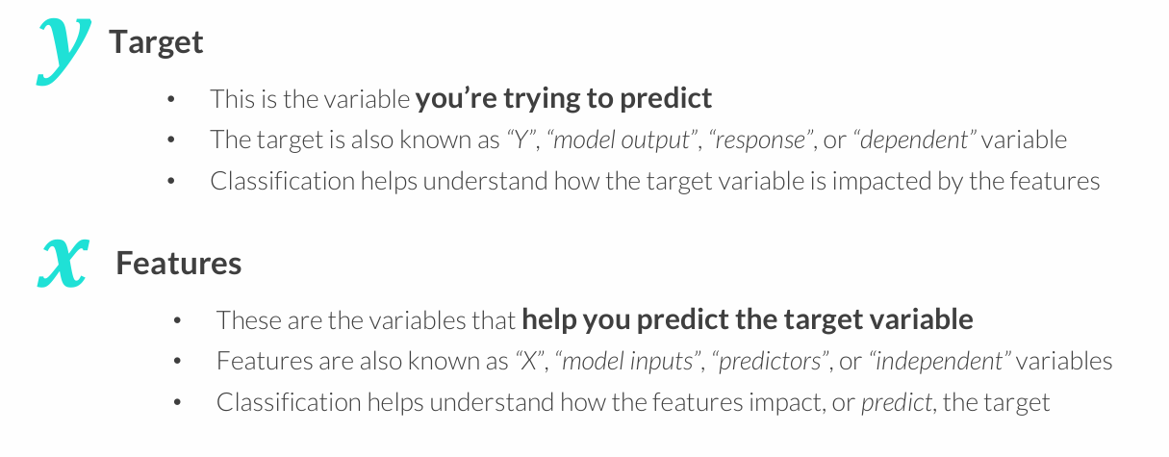
CLASSIFICATION 101
Classification analysis is a supervised learning technique used to predict a categorical variable (target) by modeling its relationship with other variables (features)

Slide 5
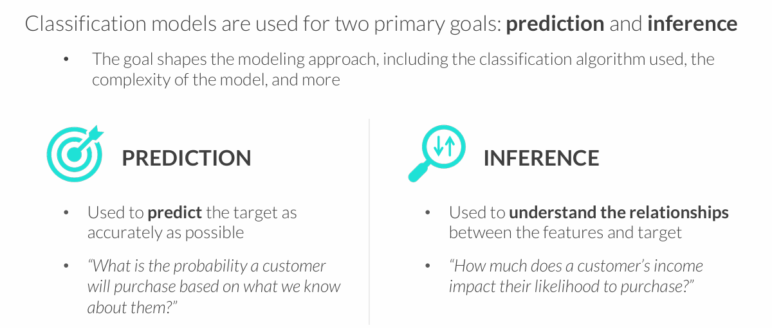
GOALS OF CLASSIFICATION
You often need to strike a balance between these goals – a model that is very inaccurate won’t be too trustworthy for inference, and understanding the impact that variables have on predictions can help make them more accurate

Slide 6
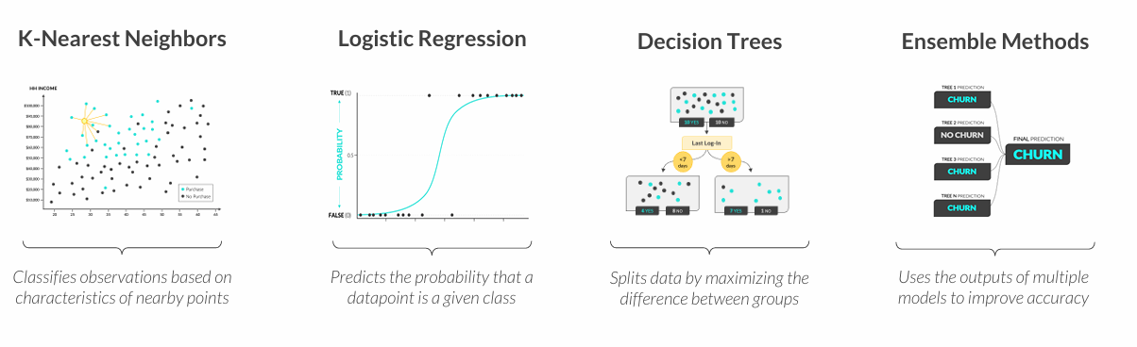
TYPES OF CLASSIFICATION
These are some of the most common types of classification modeling techniques:
All models are wrong, but some are useful
George Box

Slide 7
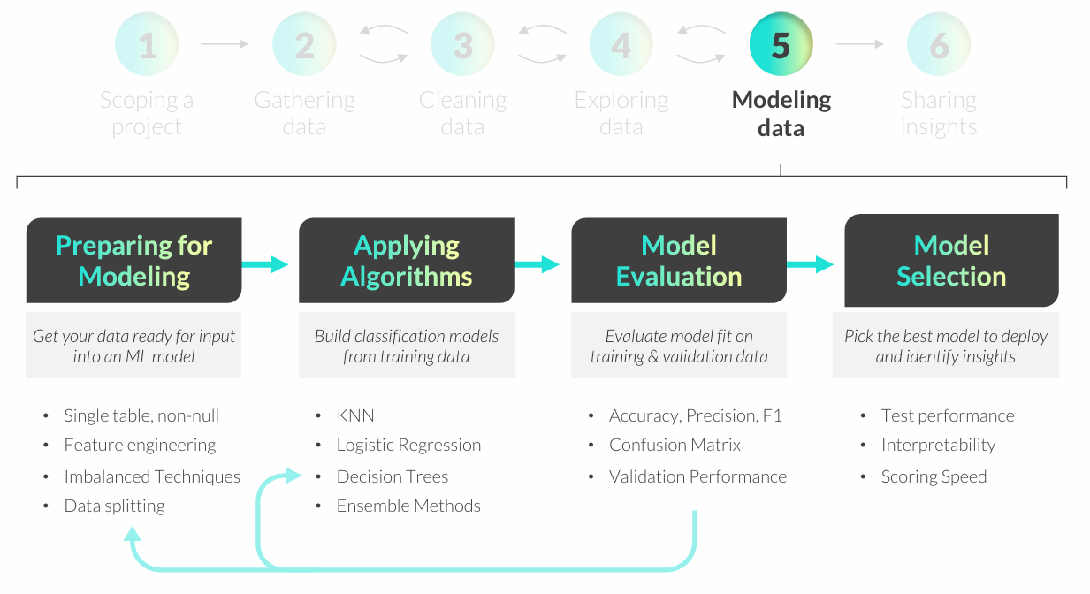
CLASSIFICATION MODELING WORKFLOW

Slide 8
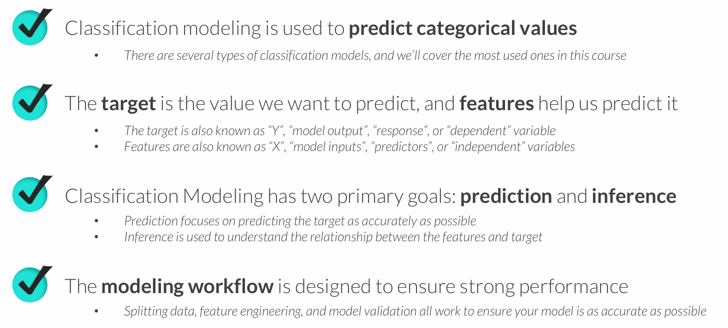
KEY TAKEAWAYS

Slide 9
K-NEAREST NEIGHBORS (KNN)
K-Nearest Neighbors (KNN) is a classification technique designed to predict outcomes based on similar observed values
• In its simplest form, KNN creates a scatter plot with training data, plots a new unobserved value, and assigns a target class based on the classes of nearby points
• K represents the number of nearby points (or “neighbors”) the model will consider when making a prediction
Example use cases:
• Predicting which customers will purchase a product based on demographics
• Classifying customers into pre-existing clusters or segments

Slide 10
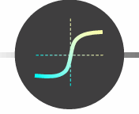
LOGISTIC REGRESSION
Logistic Regression is a classification technique used to predict the probability of a binary (true/false) outcome
• In its simplest form, logistic regression forms an S-shaped (sigmoid) curve between 0 and 1, which represents the probability of a TRUE outcome for any given value of X
• The likelihood function measures how accurately a model predicts outcomes, and is used to optimize the “shape” of the curve
• Although it has the word “regression” in its name, logistic regression is not used for predicting numeric variables
Example use cases:
• Flagging spam emails or fraudulent credit card transactions
• Determining whether to serve a particular ad to a website visitor

Slide 11

DECISION TREES
Decision Trees use a series of binary (true/false) rules to predict multi class or binary outcomes
• For each rule, a decision tree selects a single feature and uses it to split observations into two groups, where each group (ideally) skews towards one class
• The goal is to determine which rules and features do the best job splitting up the classes, which we can measure using a metric known as entropy
• This is NOT a manual process; decision trees test many variables and select rules based on the change in entropy after the split (known as information gain)
Example use cases:
• Predicting if a customer will cancel/churn next month
• Identifying fraudulent bank transactions or insurance claims

Slide 12
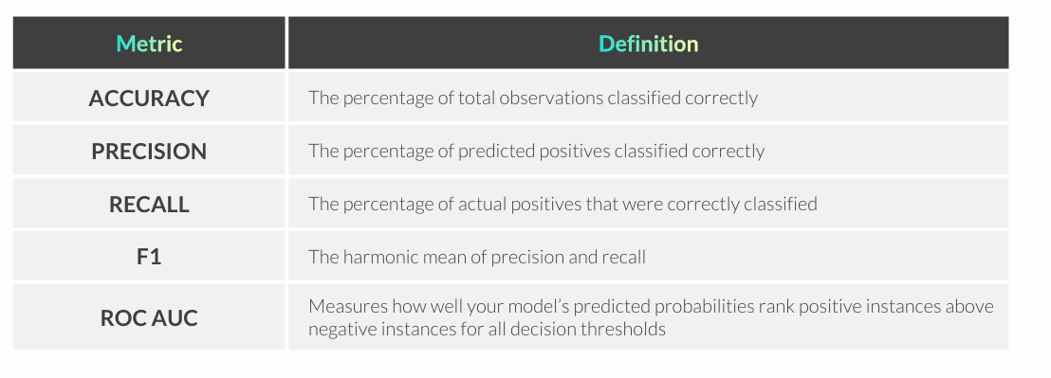
MODEL SELECTION & METRICS
Model selection describes the process of training multiple models, comparing performance on Test data, and choosing the best option
• When comparing performance, it’s important to prioritize the most relevant metrics based on the business context and the problem you are trying to solve

Slide 13
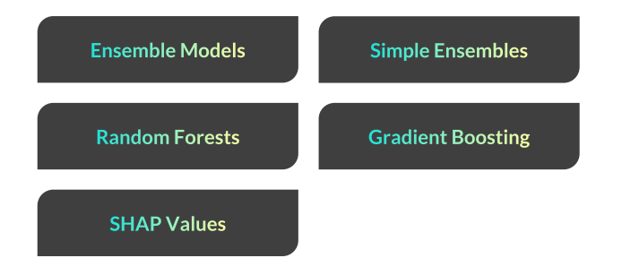
ENSEMBLE MODELS

Slide 14
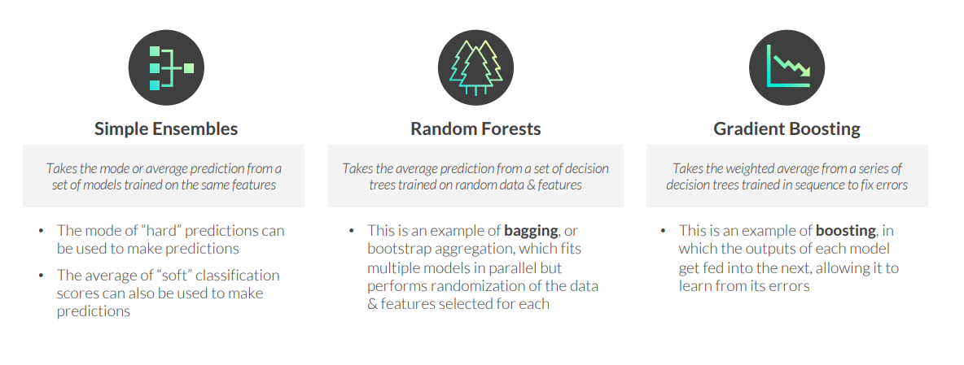
ENSEMBLE MODELS
Ensemble models use the outputs of multiple models to make predictions
• They are often more accurate than any single model, but more challenging to interpret

Slide 15
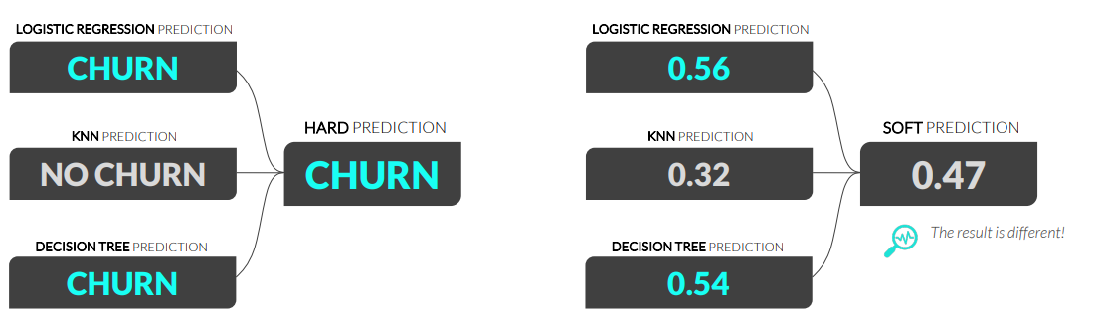
SIMPLE ENSEMBLE MODELS
Simple ensemble models are trained on the same data and features
• “Hard” predictions (majority vote ensembles) take the mode from each model’s predictions
• “Soft” predictions (probability average classifiers) take the average from the predictions
Ensembles can be configured in many ways. Data scientists could also calculate a weighted average, where the most accurate base model is given more weight than less accurate predictors.

Slide 16
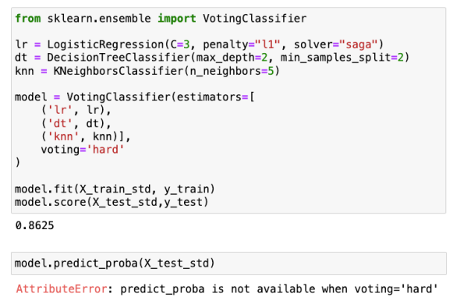
FITTING A SIMPLE ENSEMBLE MODEL
In Python, you can fit simple ensemble models using the scikit-learn library
• sklearn.ensemble.VotingClassifier(estimators, voting)
Here we’re passing in a list of tuples to the estimators argument, where the first value gives the model an internal name, and the second is the variable storing the associated model
voting=“hard” indicates this is a majority vote ensemble
PRO TIP: Using a hard vote gives you less flexibility than soft probabilities, so you’re generally better off using soft classification scores for ensemble models

Slide 17
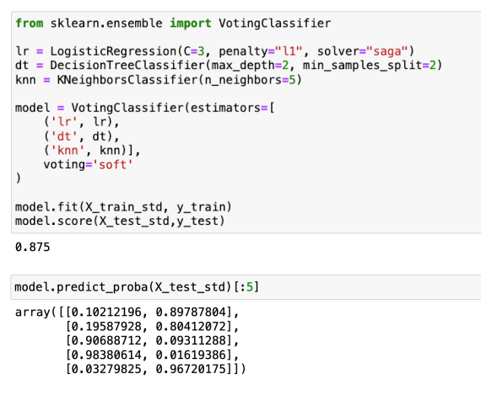
FITTING A SIMPLE ENSEMBLE MODEL
In Python, you can fit simple ensemble models using the scikit-learn library
• sklearn.ensemble.VotingClassifier(estimators, voting)
voting=“soft” indicates this is a probability average classifier
The soft probability ensemble was slightly more accurate than the hard vote, as it includes the nuance for predictions that are close to the decision threshold
You can also leverage probability scores for thresholding!

Slide 18
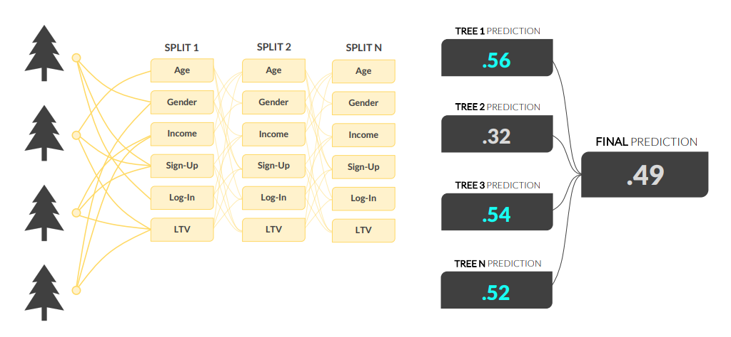
RANDOM FORESTS
A Random Forest is a collection of individual decision trees, each built using a random sample (with replacement) of observations
• Each decision tree randomly selects variables to evaluate at each split
• Each tree produces a prediction, and the mean score across the trees is used for classification

Slide 19
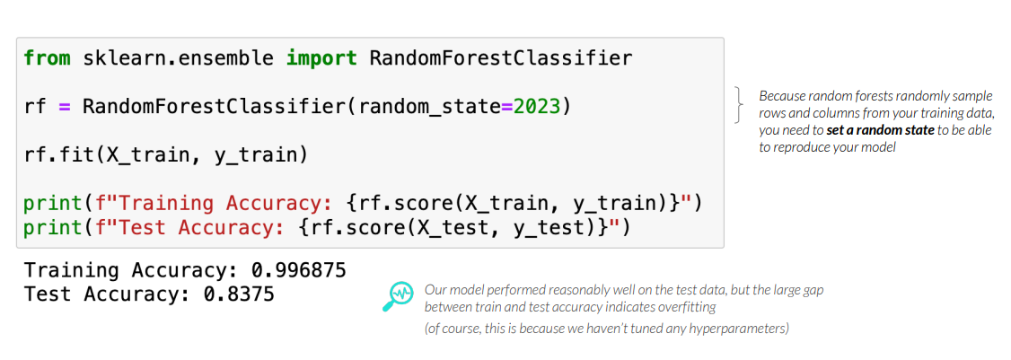
FITTING A RANDOM FOREST MODEL
In Python, you can fit a random forest model using the scikit-learn library
• sklearn.ensemble.RandomForestClassifier(random_state)

Slide 20
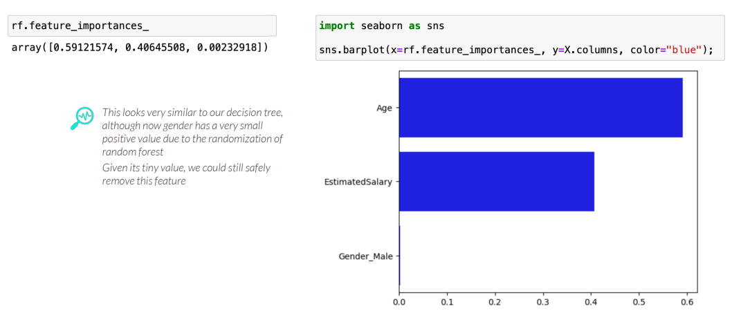
FEATURE IMPORTANCE
Like decision tree models, feature importance can help understand which features are the most impactful in random forest models

Slide 21
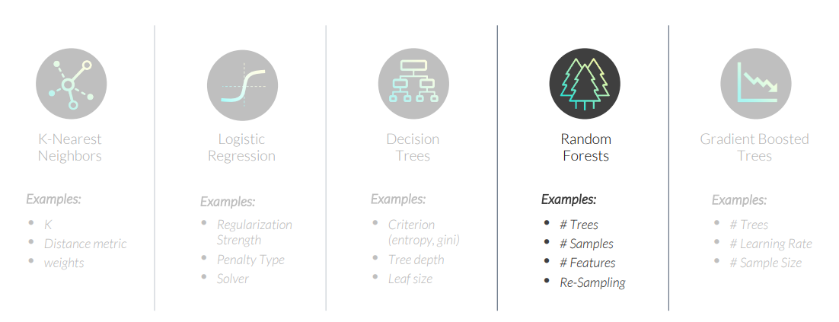
TUNING A RANDOM FOREST MODEL
Hyperparameters are settings that affect how well a model fits the data
• Unlike model parameters (like regression coefficients) these are not learned from the data
• Parameters are set before the model is fit and optimized based on validation performance

Slide 22
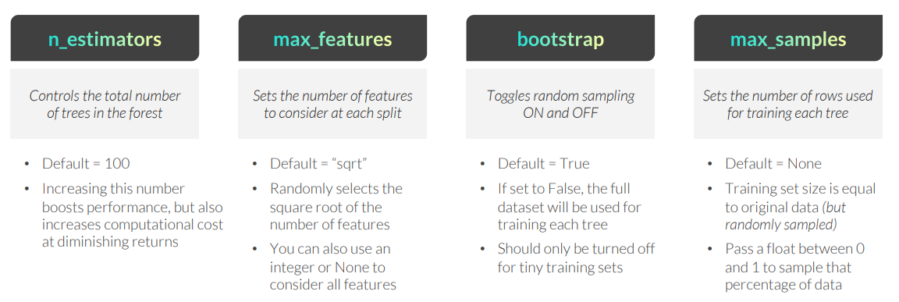
TUNING A RANDOM FOREST MODEL
The RandomForestClassifier function has many hyperparameters that can be tuned
• RandomForestClassifier(random_state, n_estimators, max_features, bootstrap, max_samples)
The max_depth and min_samples_leaf hyperparameters are also available here (like with standard decision tree models) and are applied the same way for all the trees in the random forest

Slide 23
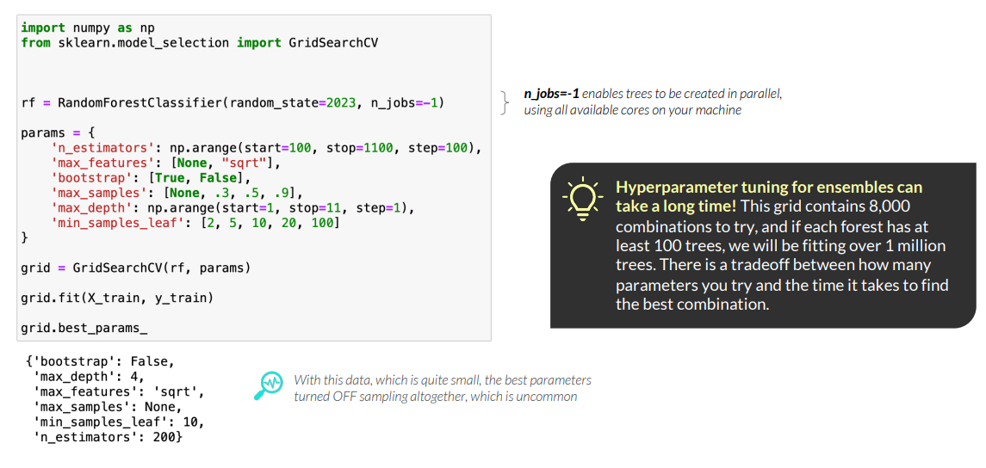
TUNING A RANDOM FOREST MODEL
You can use GridSearchCV to test various combinations of hyperparameters
• Once you’ve determined the best hyperparameters, fit a final model with them specified

Slide 24
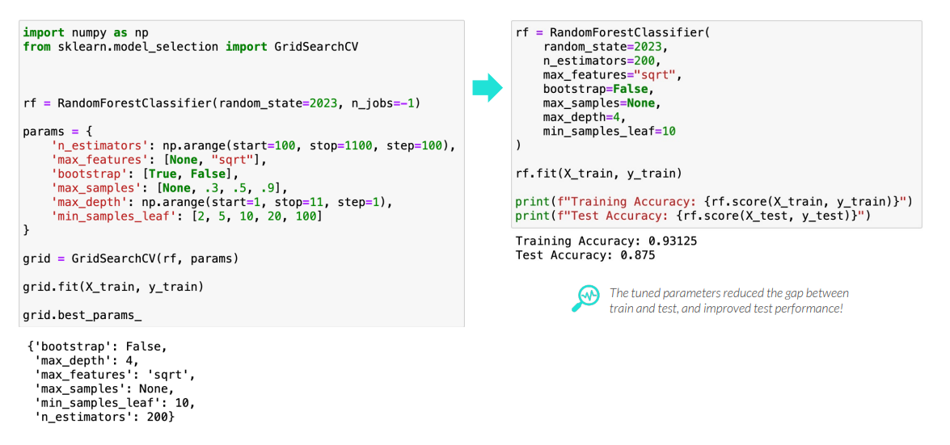
TUNING A RANDOM FOREST MODEL
You can use GridSearchCV to test various combinations of hyperparameters
• Once you’ve determined the best hyperparameters, fit a final model with them specified

Slide 25
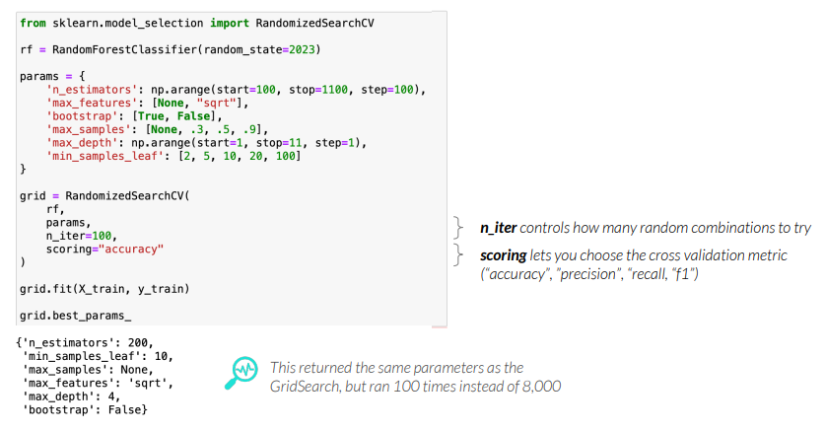
PRO TIP: RANDOM SEARCH
Tuning ensemble methods can take a long time, so RandomizedSearchCV tries a fixed number of random combinations of parameters to speed up the process
• sklearn.model_selection.RandomizedSearchCV(model, params, n_iterations, scoring)
• From best random set, you can use GridSearchCV to fine-tune your model

Slide 26
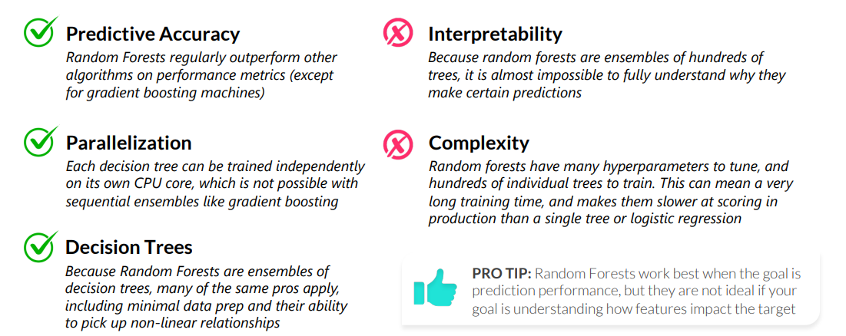
PROS & CONS OF RANDOM FORESTS
Random Forests have pros and cons that data scientists should be aware of when deciding whether it is the best model for the task at hand
• In general, random forests are strong models in terms of predictive accuracy, and address many of the drawbacks (e.g. overfitting) of decision trees. They are very hard to interpret, however.

Slide 27
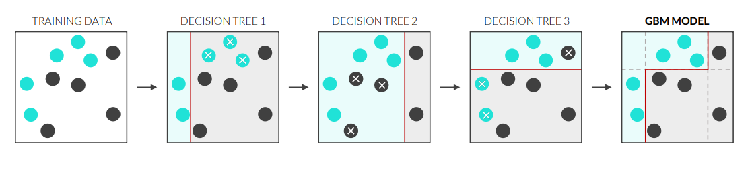
GRADIENT BOOSTED MACHINES
Gradient Boosted Machines (GBM) is a sequential ensemble technique that fits a series of decision trees that predict the error in the previous model
• These trees are combined using weighted averages to make a final prediction

Slide 28
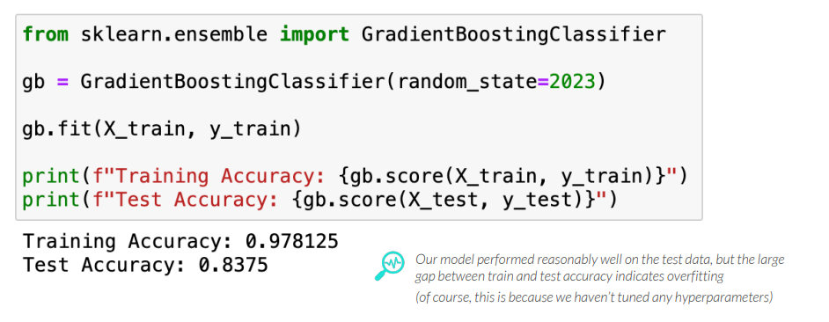
FITTING A GRADIENT BOOSTING MODEL
In Python, you can fit a gradient boosting model using the scikit-learn library
• sklearn.ensemble.GradientBoostingClassifier(random_state)

Slide 29
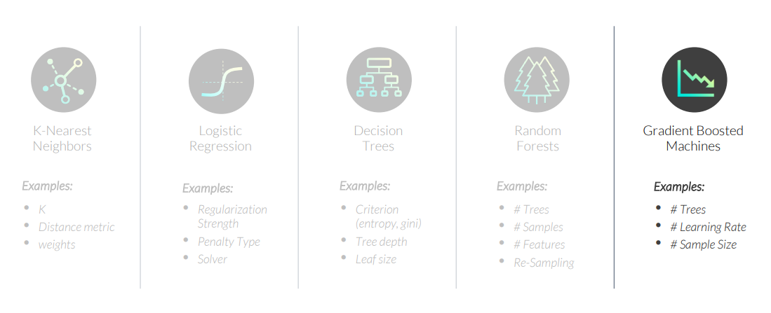
TUNING A GRADIENT BOOSTING MODEL
Hyperparameters are settings that affect how well a model fits the data
• Unlike model parameters (like regression coefficients) these are not learned from the data
• Parameters are set before the model is fit and optimized based on validation performance

Slide 30
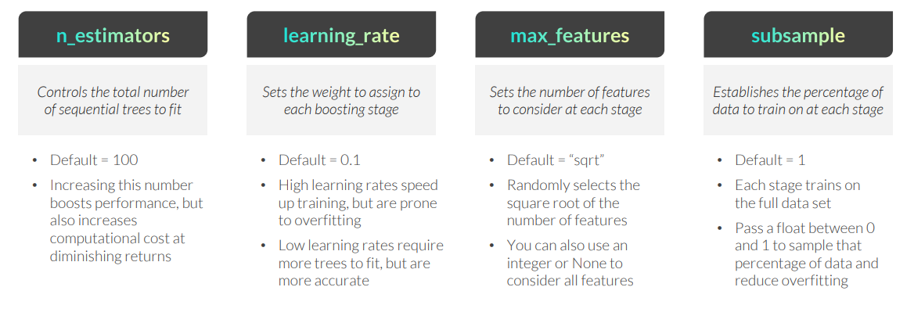
TUNING A GRADIENT BOOSTING MODEL
The GradientBoostingClassifier function has many hyperparameters to tune
• GradientBoostingClassifier(random_state, n_estimators, learning_rate, max_features, subsample)
The max_depth and min_samples_leaf hyperparameters are also available here (like with standard decision tree models and random forests) and are applied the same way for all the trees in the sequence

Slide 31
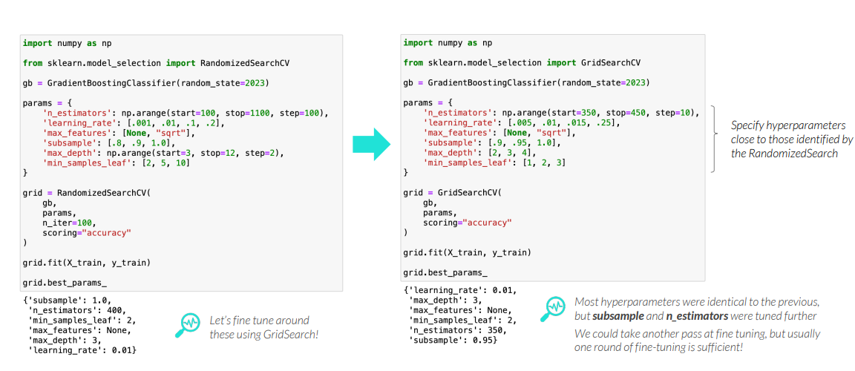
TUNING A GRADIENT BOOSTING MODEL
Use RandomizedSearchCV to identify promising hyperparameters, then use GridSearchCV to fine tune them
• Once you’ve determined the best hyperparameters, fit a final model with them specified

Slide 32
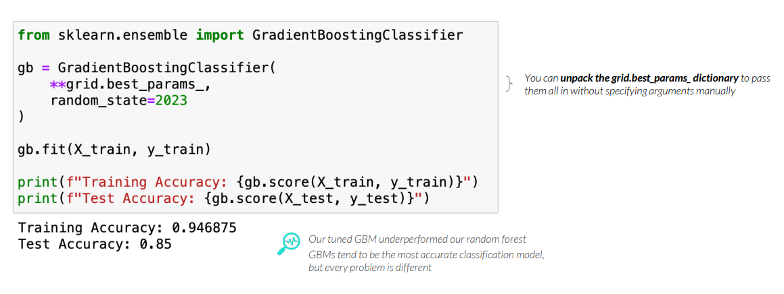
TUNING A GRADIENT BOOSTING MODEL
Use RandomizedSearchCV to identify promising hyperparameters, then use GridSearchCV to fine tune them
• Once you’ve determined the best hyperparameters, fit a final model with them specified

Slide 33
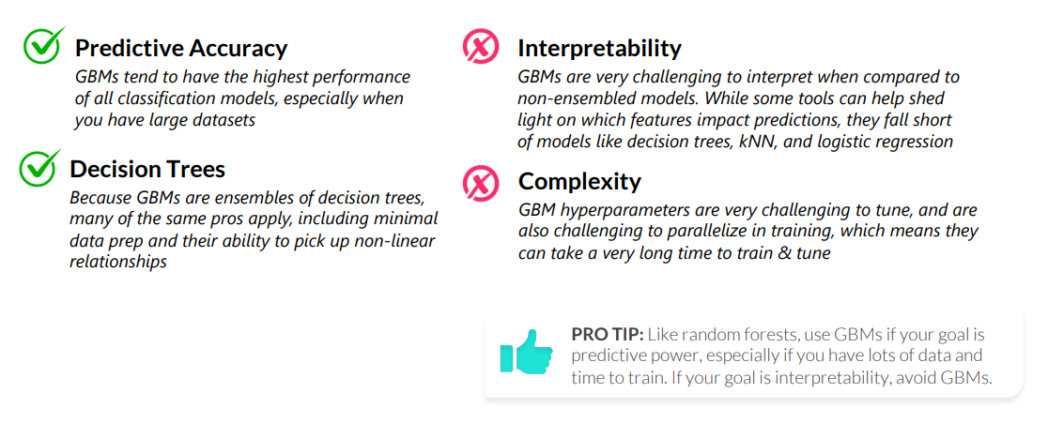
PROS & CONS OF GRADIENT BOOSTING
Gradient Boosted Machines have pros and cons that data scientists should be aware of when deciding whether it is the best model for the task at hand
• In general, GBMs are the highest performing models in terms of predictive power– they tend to win Kaggle competitions more often than other models – but this comes at the cost of complexity

Slide 34
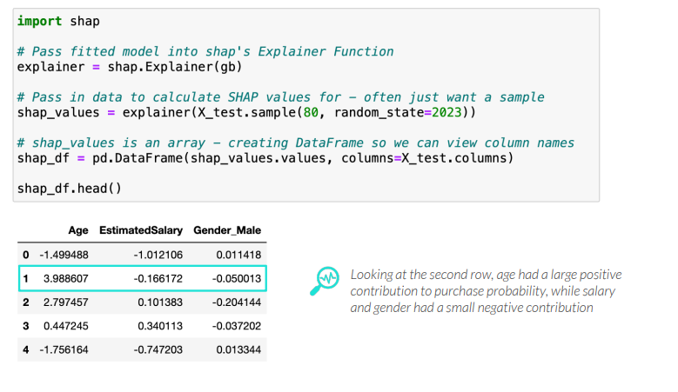
PRO TIP: SHAP VALUES
SHAP values are a framework for understanding how features impact predictions
• Based on game theory economics, they not only reveal which features are most impactful, but also give us insights into the sign (+/-) of the impact, and reveal interactions between features
• Positive SHAP values indicate a positive impact on probability, and vice versa

Slide 35
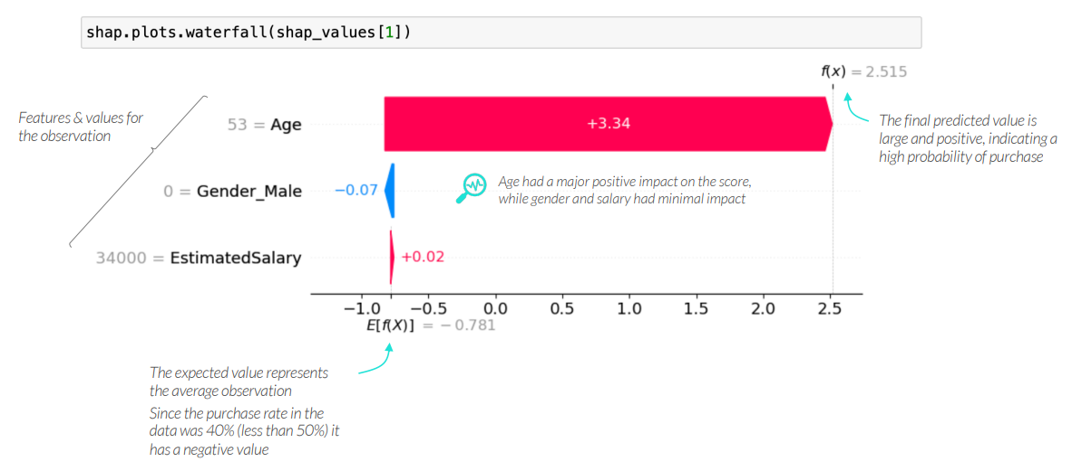
PRO TIP: SHAP WATERFALL PLOT
SHAP waterfall plots help explain how individual predictions get pushed away from the average observation

Slide 36
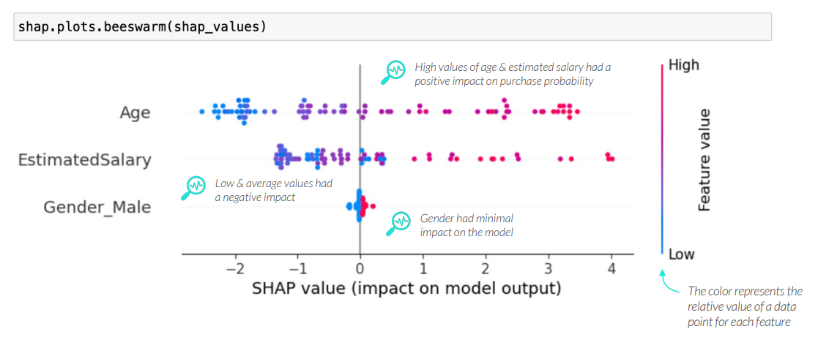
PRO TIP: SHAP BEESWARM PLOT
The SHAP beeswarm plot acts as a supercharged version of feature importance, indicating the impact and direction of each feature on each observation

Slide 37
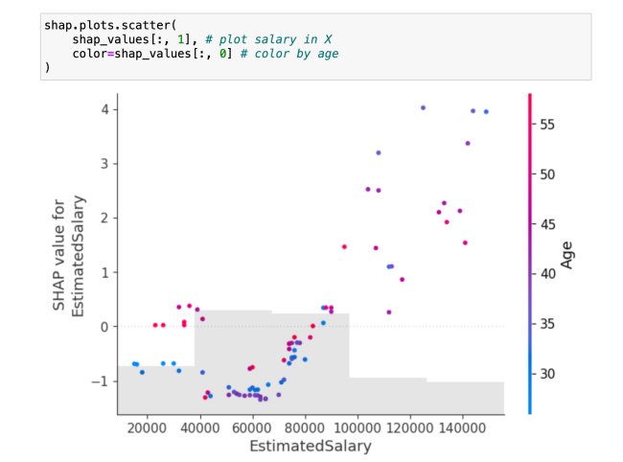
PRO TIP: SHAP DEPENDENCE PLOT
The SHAP dependence plot shows interactions between features in the data and their impact on the predictions in the model
In general, probability rises with salary Customers with high ages also have positive predicted probabilities and, as salary rises, we see more low age customers scoring high as well

Slide 38
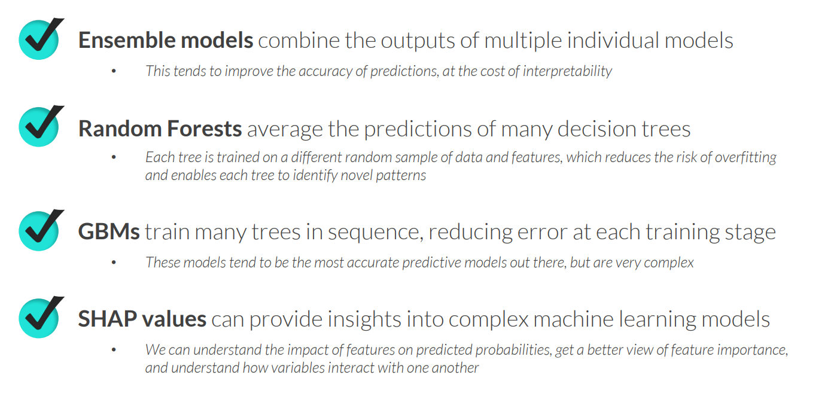
KEY TAKEAWAYS

Slide 39
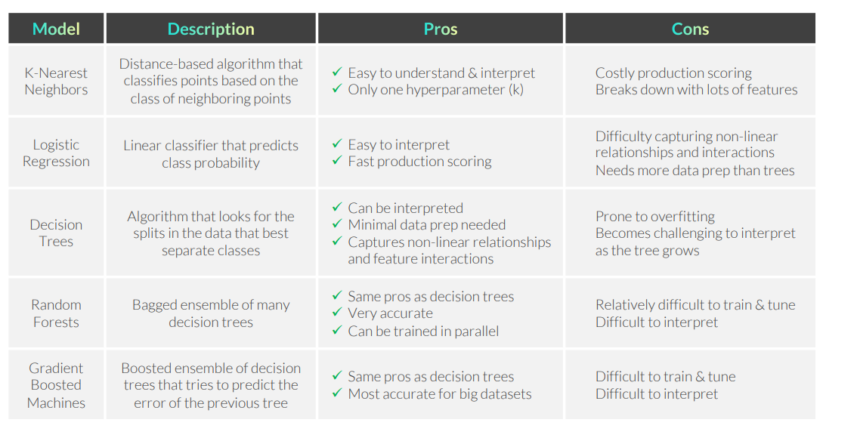
CLASSIFICATION MODEL RECAP

Slide 40
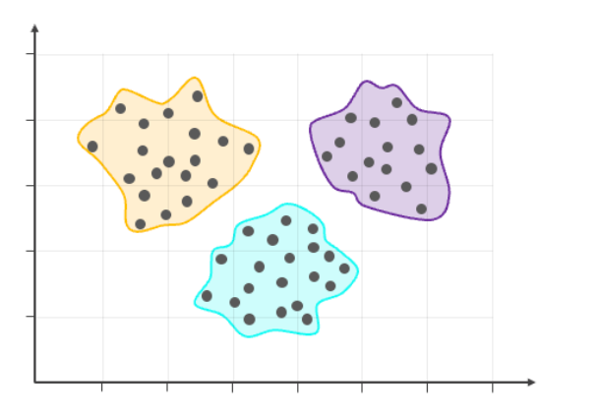
LOOKING AHEAD: UNSUPERVISED LEARNING
• Clustering Algorithms
• Anomaly Detection
• Dimensionality Reduction
• Recommender Systems •
…and More!

